Slide 1
Secure Programming 6. Buffer Overflow (Strings and Integers) Part 1
Reference:
1. B. Chess and J. West, Secure Programming with Static Analysis, Addison-Wesley, 2007.
2. R. C. Seacord, Secure Coding in C and C++, Addison-Wesley, 2006.
Chih Hung Wang

Slide 2
Introduction (1)
The best way to prevent buffer overflow vulnerabilities is to use a programming language that enforces memory safety and type safety.
Any operation that manipulates memory can result in a buffer overflow, but in practice, the mistakes that most often lead to buffer overflow are clustered around a limited set of operations.

Slide 3
Introduction (2)
In 2000, David Wagner found that nearly 50% of CERT warnings for that year were caused by buffer overflow vulnerabilities [Wagner et al., 2000].
Buffer overflow contributed to 14 of the top 20 vulnerabilities in 2006 [SANS 20, 2006]
Data collected by MITRE as part of the Common Vulnerabilities and Exposures (CVE) project show that the overall number of buffer overflow vulnerabilities being reported has not decreased meaningfully in this decade.

Slide 4
Introduction (3)
To understand the risk that buffer overflow vulnerabilities introduce, you need to understand how buffer overflow vulnerabilities are exploited.
Exploiting Software [Hogland and McGraw, 2004]
The Shellcoder’s Handbook [Koziol et al., 2004].

Slide 5
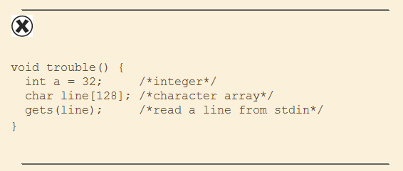
Simple Example
The simple function declares two local variables and uses gets()

Slide 6
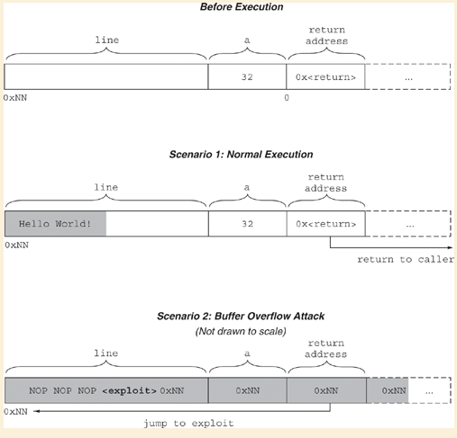
Stack Frame of the Function Truble()

Slide 7
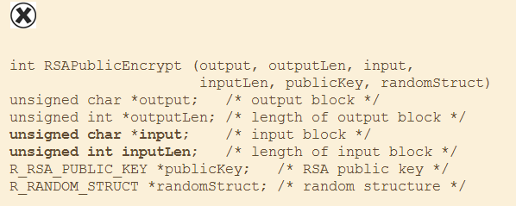
The Buffer Overflow in RSAREF

Slide 8
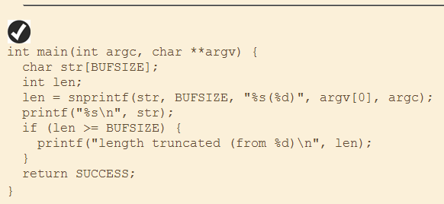
Static Buffer Allocation
Under a static buffer allocation scheme, memory for a buffer is allocated once and the buffer retains its initial size for the duration of its existence. The biggest advantage of this approach is simplicity.
snprintf and sprintf:

Slide 9
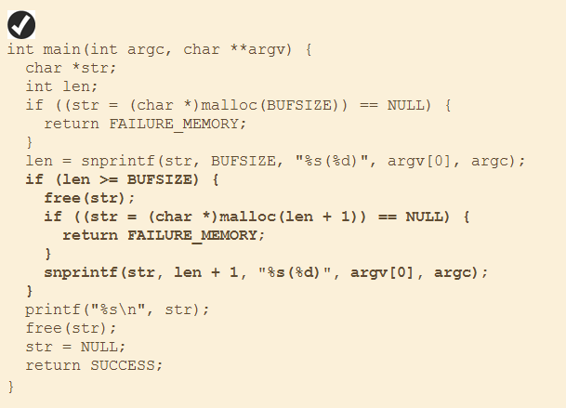
Dynamic Buffer Allocation (1)
Example of Dynamic Memory Allocation

Slide 10
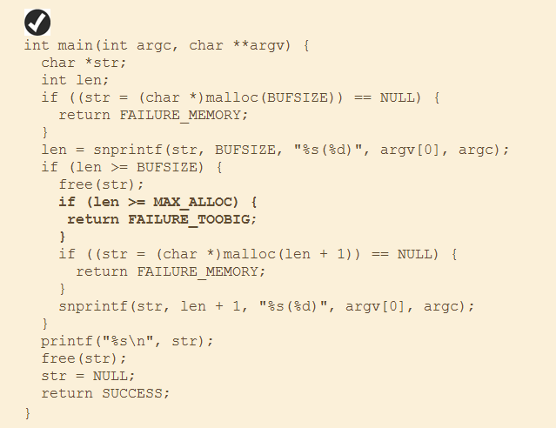
Dynamic Buffer Allocation (2)
Include a sanity check!

Slide 11
Tracking Buffer Size (1)
The most common approach to tracking a buffer and its size is to store them together in a composite data structure (such as a struct or class). This approach is akin to a rudimentary approximation of memory safety.

Slide 12
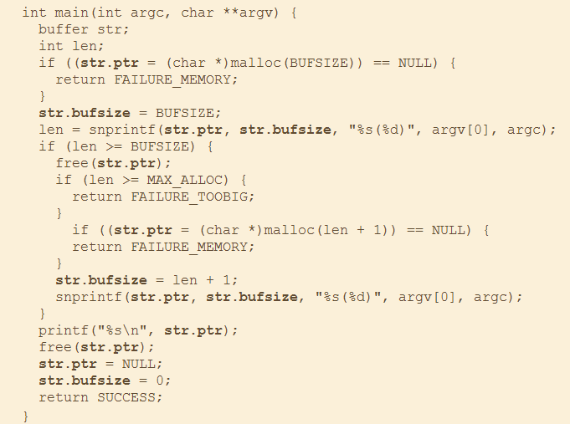
Tracking Buffer Size (2)

Slide 13
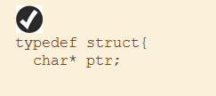
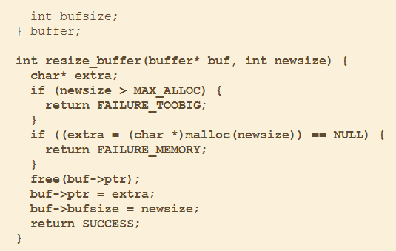
Tracking Buffer Size (3)
Include a simple helper function

Slide 14
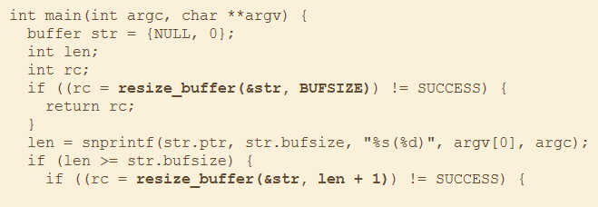
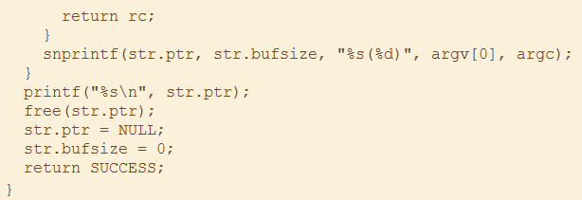
Tracking Buffer Size (4)
Continuous…

Slide 15
Strings
Inherently Dangerous Functions
gets() and friends

Slide 16
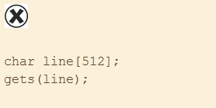
Morris Worm
The first widely publicized buffer overflow exploit was written against a vulnerability in the Berkeley fingerd daemon.
The Morris Worm leveraged the exploit to help it wreak havoc on the then-infantine Internet (approximately 60,000 computers).
The worm caused some machines to become unavailable due to the worm’s load and others to be pulled off the network to avoid infection.
See: http://seclab.cs.ucdavis.edu/projects/vulnerabilities/doves/1.html

Slide 17
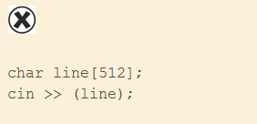
An unsafe use of the C++ Operator >>

Slide 18
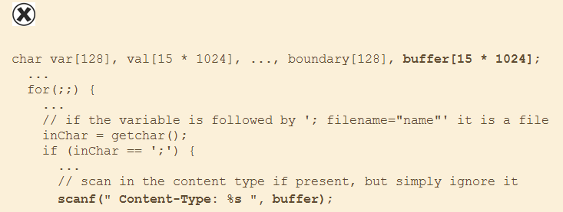
scanf() and Friends
w3-msql CGI program

Slide 19
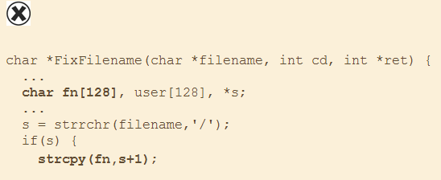
strcpy() and Friends
Code from the php.cgi program in PHP/FI 2.0beta10

Slide 20
sprintf() and Friends
To use sprintf() safely, you must ensure that the destination buffer can accommodate the combination of all the source arguments, the string size of which could vary, depending on what conversions are performed as they are formatted, and the nonformat specifier components of the format string.

Slide 21
Risk of Reimplementation (1)
Functions that are considered dangerous today were created because they provided functionality that programmers found useful. The desirable traits of functions are usually easy to identify; it’s the risks that take some thought and security awareness to uncover.
When the behavior of a dangerous function is replicated in proprietary code, the overall security of the program is worse off than if the dangerous function were used directly because it can no longer be identified by name alone.

Slide 22
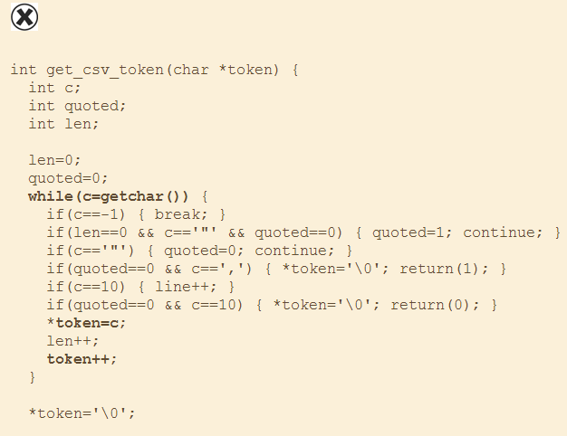
Risk of Reimplementation (2)
get_csv_token() implements a gets()-style interface because it will read an arbitrary number of bytes into a fixed-size buffer without performing any bounds checks.

Slide 23
Bounded String Operations (1)

Slide 24
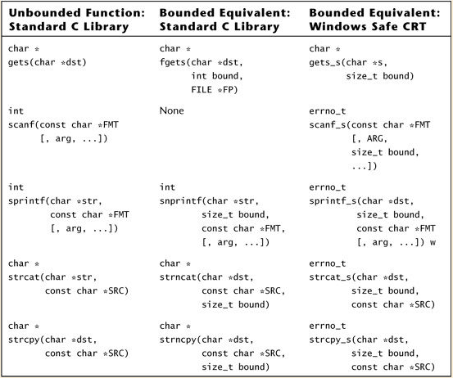
Bounded String Operations (2)

Slide 25
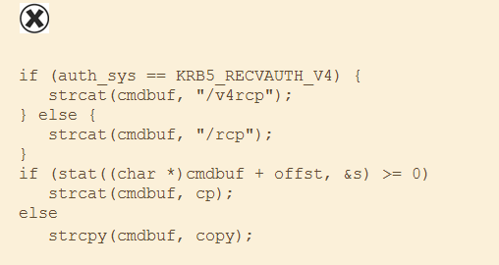
Bounded String Operations (3)
The Code of Kerberos 5 Version 1.0.6

Slide 26
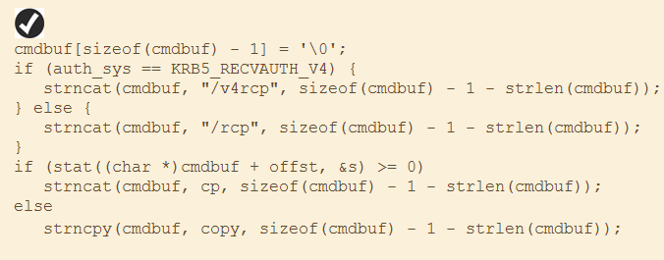
Bounded String Operations (4)
Modified Code of Kerberos 5 Version 1.0.7

Slide 27
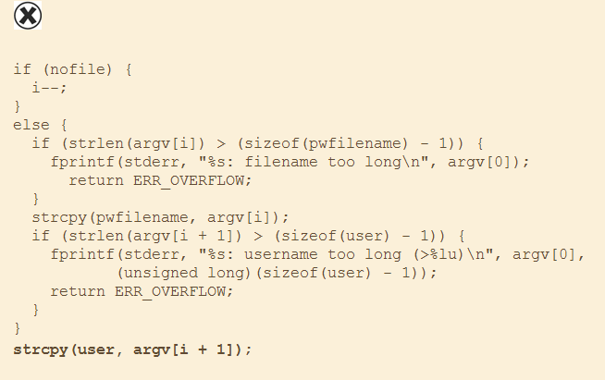
Bounded String Operations (5)
Code from Apache Version 1.31 that is susceptible to a buffer overflow because of its use of unbounded string-manipulation functions.
If the variable nofile is nonzero, a buffer overflow can occur at the second call to strcpy()

Slide 28
Common Pitfalls with Bounded Functions (1)
The destination buffer overflows because the bound depends on the size of the source data rather than the size of the destination buffer.
The destination buffer is left without a null terminator, often as a result of an off-by-one error.
The destination buffer overflows because its bound is specified as the total size of the buffer rather than the space remaining.
The program writes to an arbitrary location in memory because the destination buffer is not null-terminated and the function begins writing at the location of the first null character in the destination buffer.

Slide 29
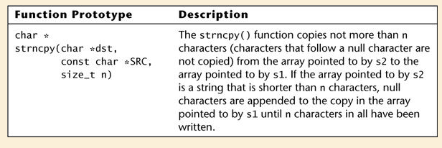
Common Pitfalls with Bounded Functions (2)
To avoid common errors with strncpy(), follow two simple guidelines:
Use a safe bound—Bound calls to strncpy() with a value derived from the size of the destination buffer.
Manually null-terminate—Null-terminate the destination buffer immediately after calling strncpy().

Slide 30
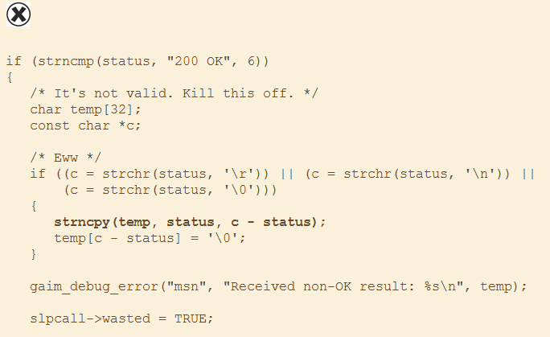
Use of a Safe Bound (1)
An unsafe call to strncpy() from Gaim

Slide 31
Use of a Safe Bound (2)
An unsafe call to strncpy() from MSDN documentation.

Slide 32
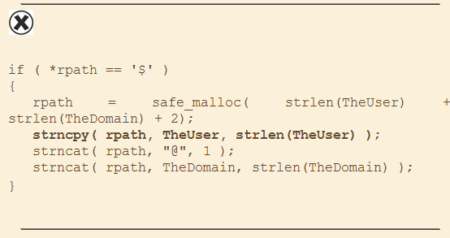
Manually Null-Terminate
This misuse of strncpy() can leave rpath unterminated and cause strncat() to overflow its destination buffer.

Slide 33
strncat()
Function prototype and description for strncat()

Slide 34
Use a Safe Bound
An unsafe call to strncat() from a patch proposed for Apache Version 1.31.
The call to strncat() could overflow record, depending on the size of user and cpw, because its bound is specified as the total size of the buffer, which already contains the values of user.

Slide 35
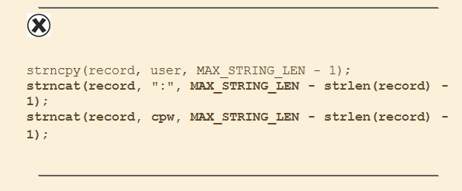
Null-Terminate Source and Destination
Code from Example 6.24 with correct bounds specified to strncat(), but truncation problems remain.

Slide 36
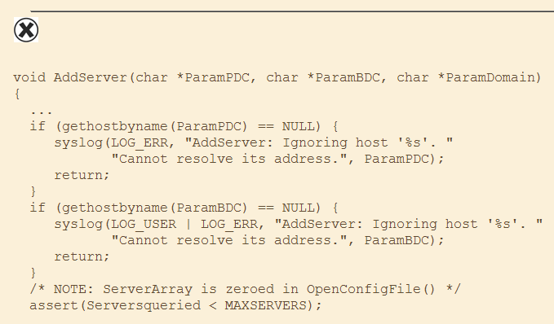
Truncation Errors (1)

Slide 37
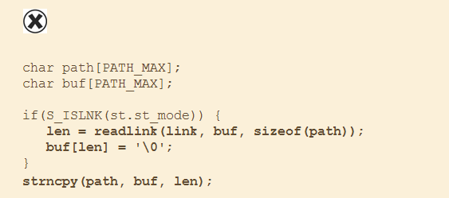
Truncation Errors (2)
A call to strncpy() that could cause a truncation error because of confusion over the behavior of readlink().

Slide 38
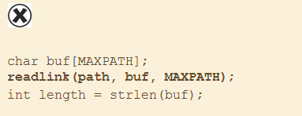
Maintaining the Null Terminator
In C, strings depend on proper null termination; without it, their size cannot be determined.

Slide 39
Character Sets, Representations, and Encoding
Most buffer overflow errors specifically related to character-encoding issues occur because of a mismatch between size in bytes of a character and the units used to bound operations on a string composed of those characters.
If characters can span multiple bytes, the difference between the number of bytes in a string and the number of characters in a string can be significant.
When an operation that expects its bound in bytes is passed a bound in characters, it can severely truncate the data on which it operates. In the opposite direction, when a function that expects its bound in characters is passed a bound in bytes, it can result in a buffer overflow that writes well beyond the allocated bounds of memory.

Slide 40
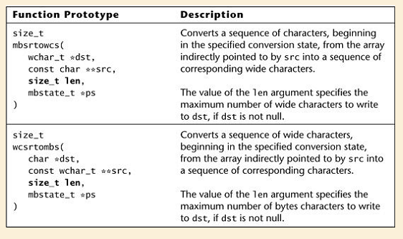
Function Prototypes and Descriptions for Standard C String-conversion Functions from the ISO C99 Standard

Slide 41
WideChar Problem

Slide 42
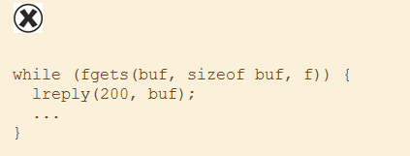
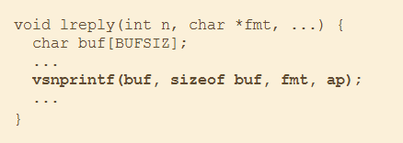
Format Strings (1)
Format string errors occur when user input is allowed to influence the format string argument to certain string formatting functions.

Slide 43
Format Strings (2)
the guidelines:
Always pass a static format string to any function that accepts a format string argument.
If a single static format string is too restrictive, define a set of valid format strings and make selections from this safe set. Accept the added program complexity of selecting from a fixed set of static format strings over the risk that a dynamically constructed string will include unchecked user input.
If a situation truly demands that a format string include input read from outside the program, perform rigorous whitelist-based input validation on any values read from outside the program that are included in the format string.

Slide 44
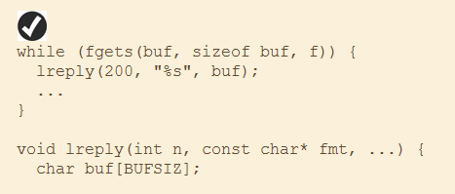
Static Format String

Slide 45
Better String and Libraries
Code that uses std::string to count the number of occurrences of a substring in a line of input.

Slide 46
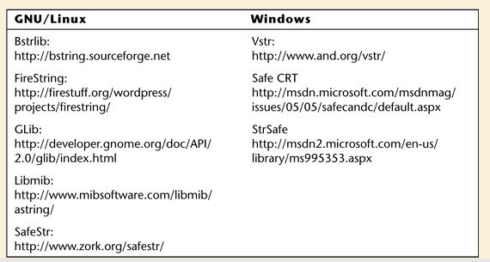
Alternative String Solutions for C under GNU/Linux and Microsoft Windows

