Slide 1
Secure Programming 5. Handling Input (Part 1)
Reference:
1. B. Chess and J. West, Secure Programming with Static Analysis, Addison-Wesley, 2007.
2. R. C. Seacord, Secure Coding in C and C++, Addison-Wesley, 2006.
Chih Hung Wang

Slide 2
What to Validate
The programmer is the most qualified individual to define the kinds of input that are valid in the context their code.
Validate all input.
Validate every piece of input the program uses. Make it easy to verify that all input is validated before it is used.
Validate input from all sources.
Validate input from all sources, including command-line parameters, configuration files, database queries, environment variables, network services, registry values, system properties, temporary files, and any other source outside your program.
Establish trust boundaries.
Store trusted and untrusted data separately to ensure that input validation is always performed.

Slide 3
How to Validate (1)
Use strong input validation
Use the strongest form of input validation applicable in a given context. Prefer indirect selection or whitelisting.
Avoid blacklisting
Do not fall back on blacklisting just because stronger input validation is difficult to put in place.
Don’t mistake usability for security.
Do not confuse validation that an application performs for usability purposes with input validation for security.
Reject bad data
Reject data that fail validation checks. Do not repair it or sanitize it for further use.
Make good input validation the default
Use a layer of abstraction around important or dangerous operations to ensure that security checks are always performed and that dangerous conditions cannot occur.

Slide 4
How to Validate (2)
Always check input length
Validate input against a minimum expected length and a maximum expected length.
Bound numeric input
Check numeric input against both a maximum value and a minimum value as part of input validation. Watch out for operations that might be able to carry a number beyond their maximum or minimum value.

Slide 5
What to Validate – More Detail (1)
Validate all inputs
Input validation routines can be broken down into two major groups: syntax checks that test the format of the input, and semantic checks that determine whether the input is appropriate, given the application’s logic and function.

Slide 6
What to Validate – More Detail (2)
Validate input from all sources
Command-line parameters
Configuration files
Data retrieved from a database
Environment variables
Network services
Registry values
System properties
Temporary files

Slide 7
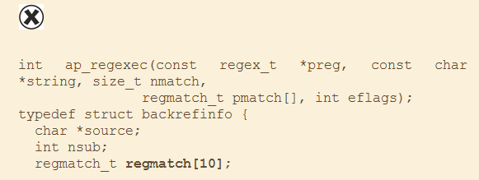
What to Validate – More Detail (3)
Configuration files
A buffer overflow in Apache: A user who can modify an .htaccess file can crash the server or execute arbitrary code as the server by writing a regular expression with more than nine capturing groups.

Slide 8
What to Validate – More Detail (4)
The invalid input
RewriteRule ^/img(.*) /var/www/img$1
But the following input causes a buffer overflow:
RewriteRule ^/img(.)(.)(.)(.)(.)(.)(.)(.)(.)(.*) \ /var/www/img$1$2$3$4$5$6$7$8$9$10

Slide 9
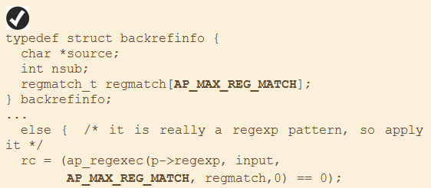
What to Validate – More Detail (4)
Fox it: the array declaration and the code that fills the buffer now both refer to the same constant.

Slide 10
What to Validate – More Detail (5)
Command-Line Parameters
Up through Version 2.1.9, Hibernate, a popular open source package for object/relational mapping, contains an excellent example of what not to do with command line input.
The Java version of Hibernate’s SchemaExport tool accepts a command-line parameter named "--delimiter", which it uses to separate SQL commands in the scripts it generated.

Slide 11
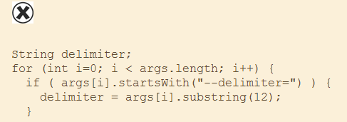
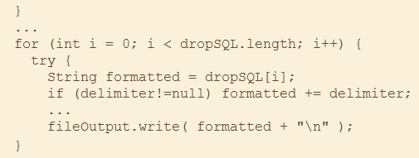
What to Validate – More Detail (6)
SQL injection through the command line

Slide 12
What to Validate – More Detail (7)
SELECT * FROM items WHERE owner = "admin";
But if the same query was issued with the malicious option --delimiter '; DELETE FROM items;', it would generate a script that cleans out the items table with the following commands:
SELECT * FROM items WHERE owner = "admin"; DELETE FROM items;

Slide 13
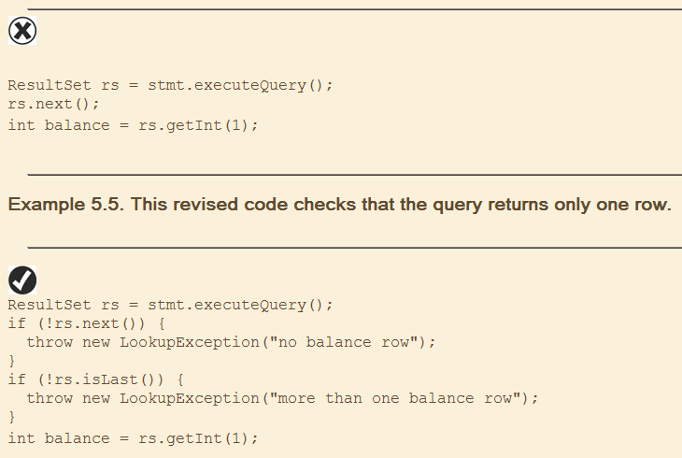
What to Validate – More Detail (8)
Database Queries
No effort to verify the number of rows the query returns; it simply uses first row found

Slide 14
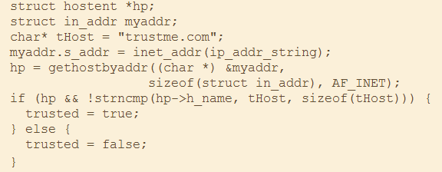
What to Validate – More Detail (9)
Network Services
The code mistakenly relies on DNS to establish trust

Slide 15
Story- Apple OS X: Software Updates That Trust Too Much
Apple’s OS X operating system knows how to phone home to get software updates, but early versions didn’t check to make sure they were pulling down updates from a benevolent server. Russell Harding discovered the problem in 2002.He explained it and released exploit tools at the same time.
DNS querry
dnsspoof
ARP Spoofing

Slide 16
What to Validate – More Detail (10)
Establish Trust Boundaries
This Java code accepts an HTTP request parameter name status and stores it in the HTTP session object without performing any validation on the value.
Because data stored in the session are usually treated as trusted, this is a trust boundary violation.

Slide 17
What to Validate – More Detail (11)
The unvalidated input stored in the HTTP session in the previous example is printed later in the same JSP page.
Although the value comes from an HTTP session object, which is typically trusted, the USER_STATUS attribute was never validated, making this a cross-site scripting vulnerability.

Slide 18
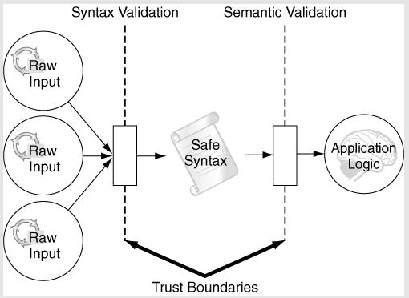
What to Validate – More Detail (12)
Enforce Trust Boundaries

Slide 19
How to Validate – More Detail (1)
Use Strong Input Validation
The right approach to input validation is to check input against a list of known good values. Checking against a list of known good values is called whitelisting.
Indirect Selection
The form of input validation isn’t always practical, but it is ideal for situations in which a user is selecting from among a list of choices.

Slide 20
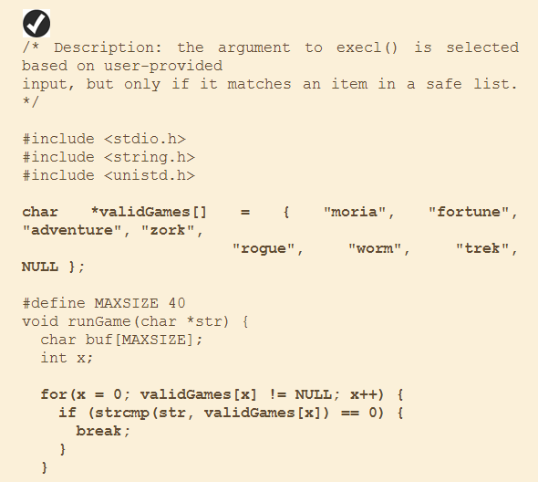
How to Validate – More Detail (2)
Indirect selection 1

Slide 21
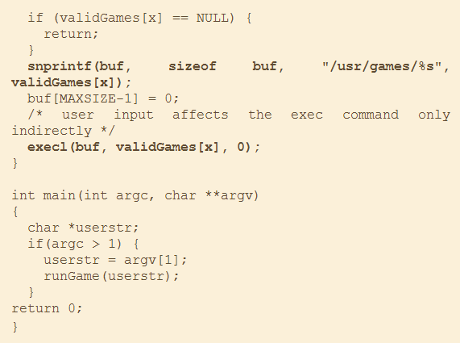
How to Validate – More Detail (3)
Indirect selection 2

Slide 22
How to Validate – More Detail (4)
Whitelisting (1)
In many situations, indirection is infeasible because the set of legitimate values is too large or too hard to track explicitly. If you need to accept a phone number as input, keeping a list of all legitimate phone numbers is not a realistic option. The best solution in such cases is to create a whitelist of acceptable input values.

Slide 23
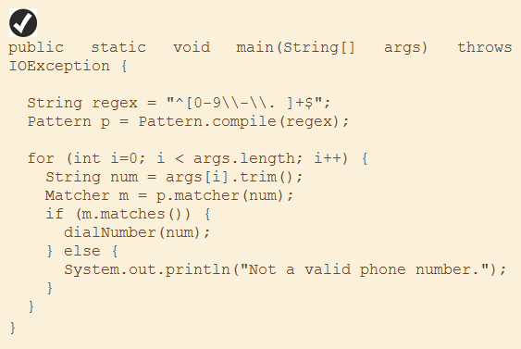
How to Validate – More Detail (5)
Phone number example

Slide 24
How to Validate – More Detail (6)
Another Example of Phone number

Slide 25
Real Example in Java (1)
Phone number (Java code)
package phone1;
import java.util.regex.Pattern;
import java.util.regex.Matcher;
import java.util.Scanner;
public class Phone1 {
public static void main(String[] args) {
String regex= "^[0-9\\-\\. ]+$";
String instr;
Scanner scn=new Scanner(System.in);
Pattern p=Pattern.compile(regex);
System.out.println("Enter your phone number: ");
instr=scn.nextLine();
Matcher m=p.matcher(instr);
if(m.matches())
System.out.println("Good! It is a valid phone number! " + instr);
else
System.out.println("It is NOT a valid phone number!");
}
}
Notes:
0-9 or "-" or "." or space can pass the checking.
Succ: 111 222.333-444
Fail: 111 222-333.aaa

Slide 26
Real Example in Java (2)
Another example for phone number
package phone2;
import java.util.regex.Pattern;
import java.util.regex.Matcher;
import java.util.Scanner;
public class Phone2 {
public static void main(String[] args) {
String sepc="\\s*[.-]?\\s*";
String regex= "(1"+sepc+")?\\d{3}"+sepc+"\\d{3}"+sepc+"\\d{4}";
String instr;
Scanner scn=new Scanner(System.in);
Pattern p=Pattern.compile(regex);
System.out.println("Enter your phone number: ");
instr=scn.nextLine();
Matcher m=p.matcher(instr);
if(m.matches())
System.out.println("Good! It is a valid phone number! " + instr);
else
System.out.println("It is NOT a valid phone number!");
}
}
Notes:
Succ: 1 222-333.4444
Fail: 2 333-444.5555
Length limitation

Slide 27
Real Example in Java (3)
Regular Expression in Java Testing
RegExr : Online Regular Expression Testing Tool http://gskinner.com/RegExr/

Slide 28
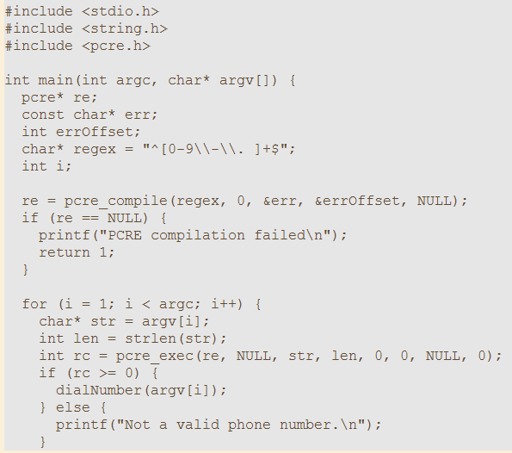
How to Validate – More Detail (7)
Regular Expression in C and C++
Open source Perl Compatible Regular Expressions (PCRE) library (http://www.pcre.org).

Slide 29
How to Validate – More Detail (8)
Avoid Blacklisting (1)
When a whitelist seems too restrictive or difficult to construct, developers often retreat to blacklisting.
Blacklisting selectively rejects or escapes potentially dangerous input values or sequences. In other words, a blacklist rejects only data known to be bad.

Slide 30
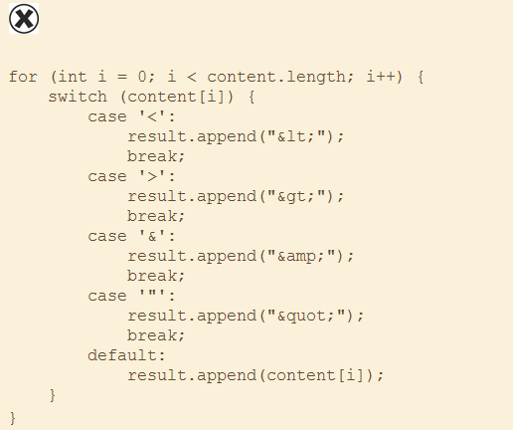
How to Validate – More Detail (9)
Example of Blacklisting

Slide 31
How to Validate – More Detail (10)
Imagine a Web site that attempts to be friendly by addressing users by name. In an effort to prevent people from writing their own content into the site, all input, including the user’s name, is run through the previous blacklist. Consider the following excerpt from a JSP on the site:

Slide 32
How to Validate – More Detail (11)
Story – Transforming Input: From Wrong to Right and Back Again
Double decode vulnerability
The purpose of the code is to return a file handle for a filename that is URL encoded. The function openEncodedFilename() performs an input validation check (implementation not shown) to make sure that the filename to be opened doesn’t contain characters that might have special meaning to the filesystem, such as a dot (.), slash (/), or backslash (\). The problem is that, after the security check is performed, the function openFile() calls urlDecode() a second time.

Slide 33
How to Validate – More Detail (12)
The code intends to make it impossible to open a file with a name such as this: c:\windows\system32\config\sam
To bypass the security check, URL-encode the name: c%3A%5Cwindows%5Csystem32%5Cconfig%5Csam Then URL-encode it again: c%253A%255Cwindows%255Csystem32%255Cconfig%255Csam
If you use this doubly encoded value as the input to the program, the function openEncodedFilename() will decode its input, and securityCheck() will see this string: c%3A%5Cwindows%5Csystem32%5Cconfig%5Csam The string will pass the security check and then be passed into openFile().

Slide 34
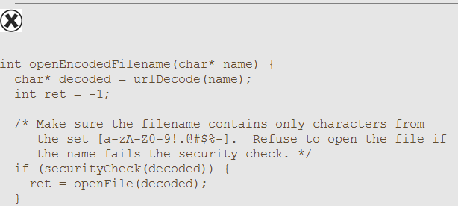
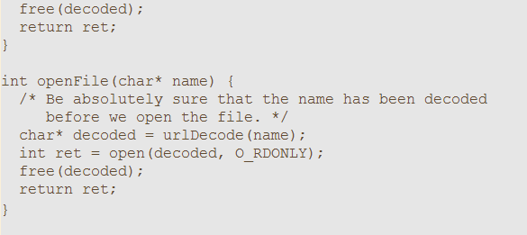
How to Validate – More Detail (13)
Double decode example

Slide 35
How to Validate – More Detail (14)
Don’t mistake usability for security
Do not confuse validation that an application performs for usability purposes with input validation for security.
User-friendly input validation is meant to catch common errors and provide easy-to-understand feedback to legitimate users when they make mistakes.

Slide 36
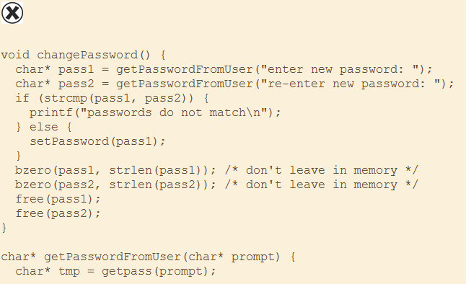
How to Validate – More Detail (15)
This C code asks a user to enter the new password twice. It’s a nice thing to do from a usability standpoint, but it doesn’t prevent an attacker from entering malicious data.

Slide 37
How to Validate – More Detail (16)
Continuous…
This is a friendly thing to do, and it probably reduces the amount of work that system administrators need to do as a result of people mistyping their new password, but it does nothing for security: It does not prevent a malicious user from entering a password that is longer than the underlying setPassword() function expects or that contains metacharacters that will enable an attack on another part of the system.

Slide 38
How to Validate – More Detail (17)
Reject Bad Data
Do not repair data that fail input validation checks. Instead, reject the input.
The automated error-recovery code could change the meaning of the input or short-circuit portions of the validation logic.

Slide 39
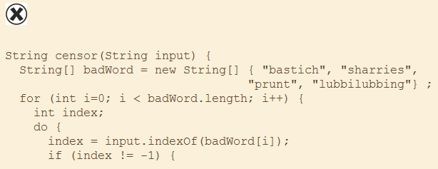
How to Validate – More Detail (18)
This Java method attempts to both blacklist and sanitize “dangerous” data by removing curse words, but fails in its goal.

Slide 40
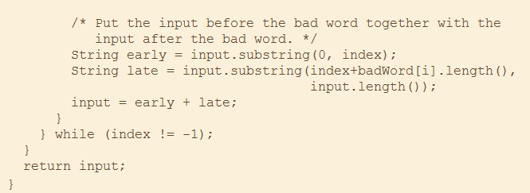
How to Validate – More Detail (19)
Continuous…

Slide 41
Directory Traversal Attack (1)
The following example is dangerous because of the non-checking of the GET function.
<?php header('Content-Type: text/ plain');
readfile($_GET['file']);
?>

Slide 42
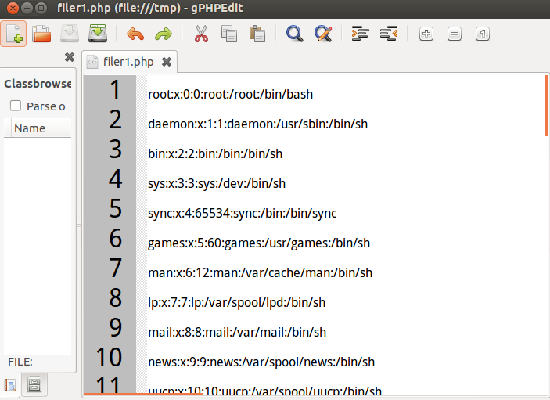
Directory Traversal Attack (2)
The attacker inputs the following URL:
http://120.113.173.21/filer1.php?file=../../etc/passwd
Can get the password file …

Slide 43
Directory Traversal Attack (3)
Directory Traversal Prevantation
Using basename() as the following
Try the link: http://120.113.173.21/filer1m1.php?file=../../etc/passwd cannot see the content of the file.
<?php header('Content-Type: text/ plain');
readfile(basename($_GET['file']));
?>

Slide 44
Directory Traversal Attack (4)
Using whitelist to solve the problem.
See the following example:
<?php header('Content-Type: text/ plain');
$all = array("1.txt", "2.txt", "3.txt");
if (!in_array($_GET['file'], $all))
die("Filename is invalid!");
readfile($_GET['file']);
?>

Slide 45
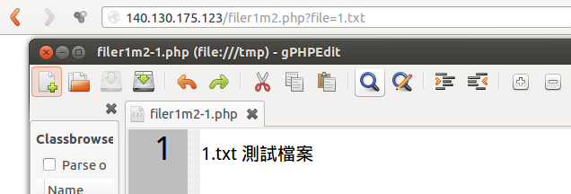
Directory Traversal Attack (5)
The attacker input…
http://120.113.173.21/filer1m2.php?file=../../etc/passwd
The attacker input…
http://120.113.173.21/filer1m2.php?file=1.txt

Slide 46
Directory Traversal Attack (6)
Don’t try to modify the user’s input.
You have better to reject the bad data.
The following program removes '../' from $_GET['file'].
<?php header('Content-Type: text/ plain');
$new_file=str_replace('../','',$_GET['file']);
readfile($new_file);
?>

Slide 47
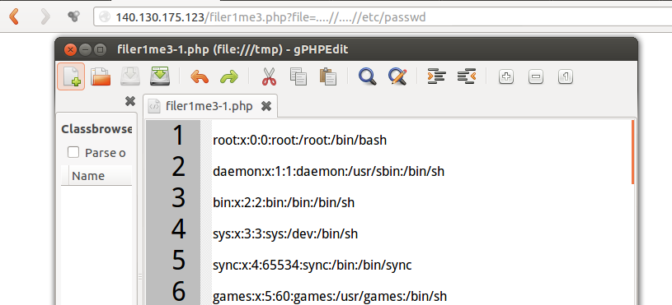
Directory Traversal Attack (7)
However, the attacker can try the following attacking command:
http://140.130.175.123/filer1me3.php?file=....//....//etc/passwd

Slide 48
Directory Traversal Attack (8)
Directly reject the bad data.
<?php header('Content-Type: text/ plain');
if (strstr($_GET['file'], '../'))
die("Filename is invalid!");
readfile($_GET['file']);
?>

